Slide 1

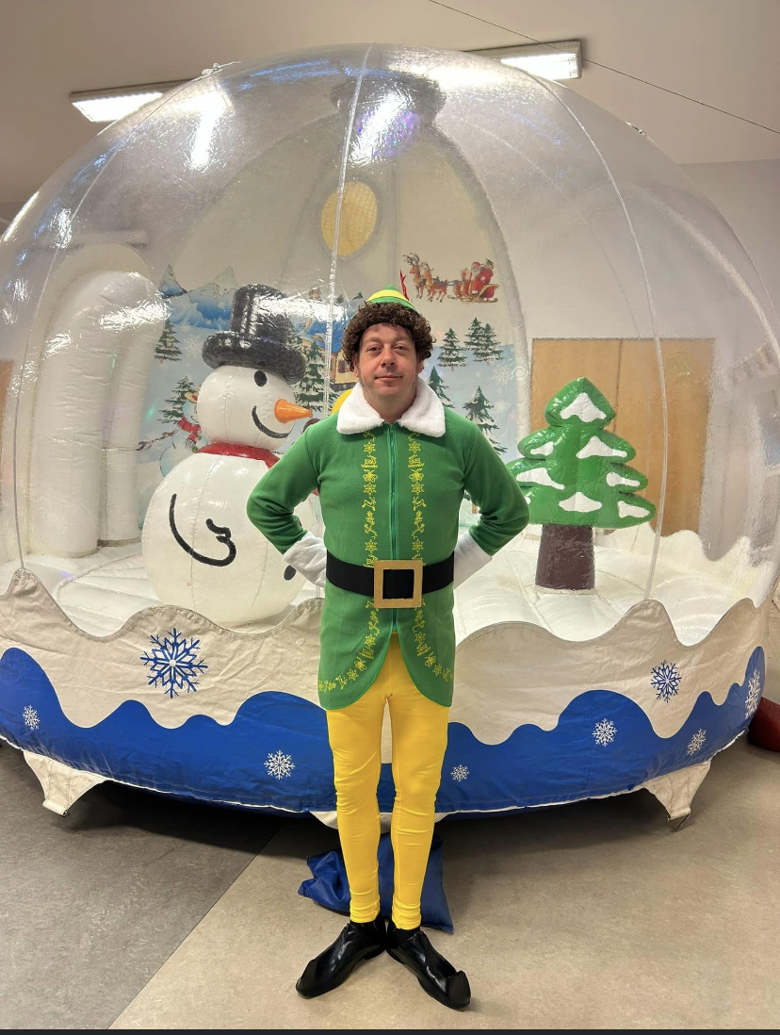
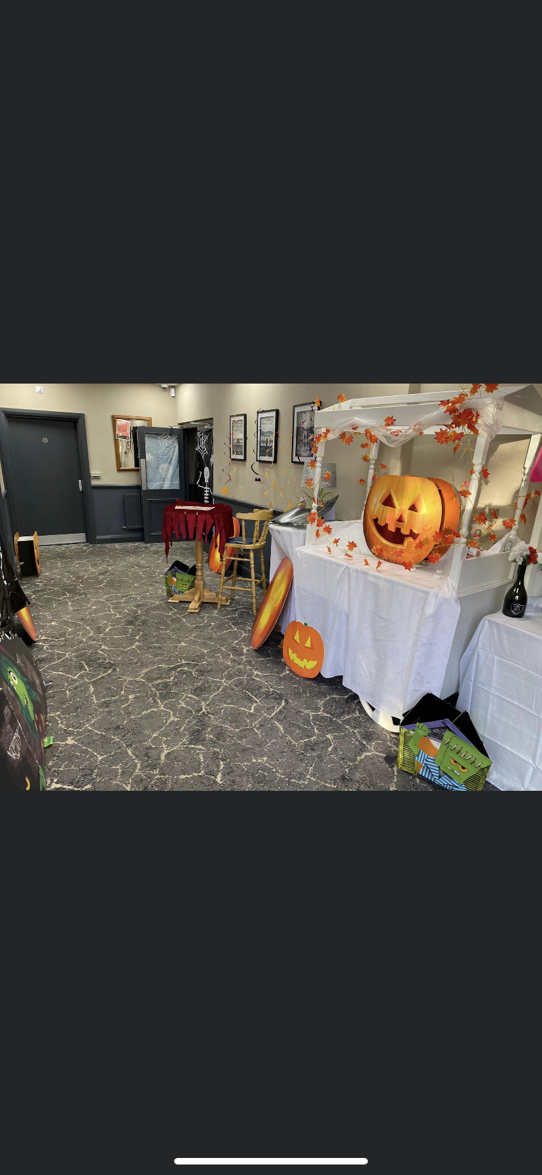
Friends of Welton School
Winter Newsletter
Last year’s events
Since September 2023 we have hosted a number of events for the pupils and parents of the school and community.
Our Halloween disco and Christmas disco are always popular and so much fun for the children. These events are also really important for us as they make a huge profit and all this goes back into the school. We always look forward to planning the disco and welcome any new ideas for the evenings.
Back this year after such a long break was the Christmas fair. With a humongous snowglobe in the school hall, stalls, chocolate tombola, book sale and more it was so good to host this event once again at the school and we hope it will become a regular event again. The money raised at the Christmas fair meant that we could surprise all the children with a highly entertaining magician on their last day of term before the Christmas break so thank you to everyone who helped, donated and supported this.

Slide 2
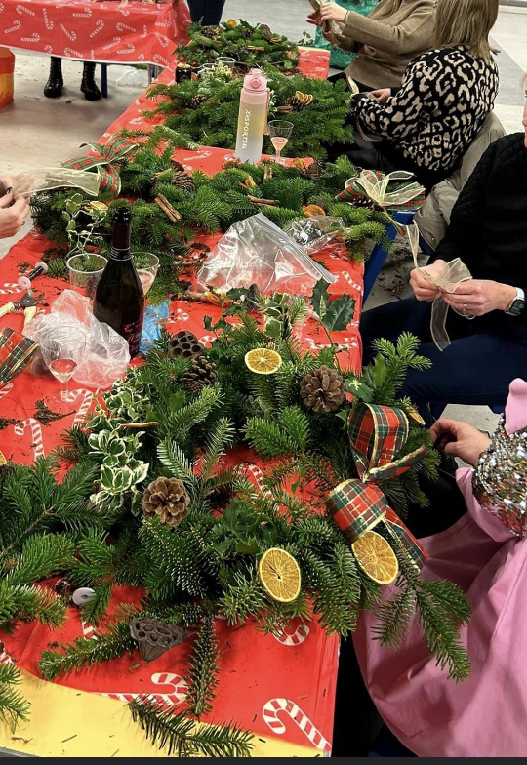
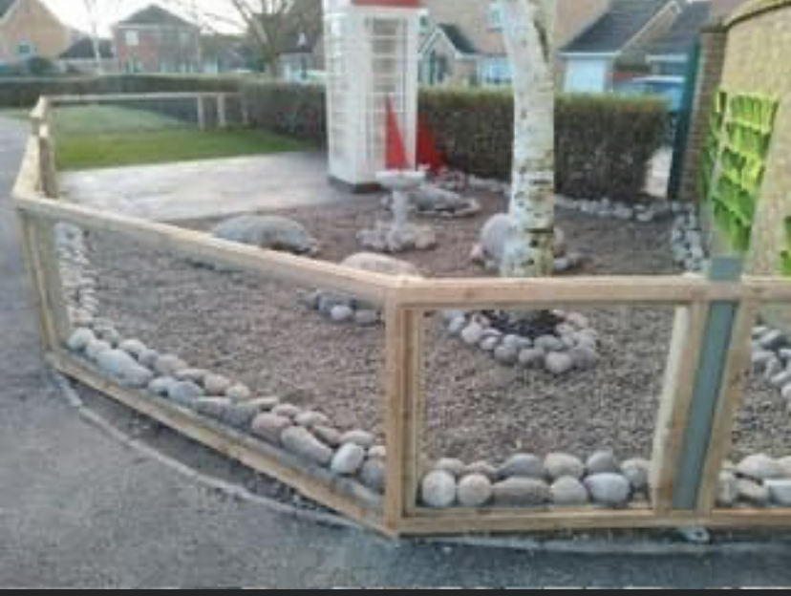
We held another wreath making night this year in December
which for the second year running has been a lovely relaxing enjoyable evening for the adults.
We have had a Halloween design competition and also the opportunity for parents to purchase Christmas cards of their child’s own design. I think it’s safe to say there has been a lot of FOWS events since September!!
Where does the money go
We often get asked where does the money go? What is it spent on?
Since September a great deal of money has been spent on the new community library area at the front of the school. This has been a large project and the money to pay for this has been raised over many years of fundraising events. The project has the best part still to be installed, a glass geodome which will look very impressive for our school and be such a useful space for all weathers.
The forest school development is also ongoing and once the planting has taken place the area will look transformed and can be enjoyed by all pupils.

Slide 3
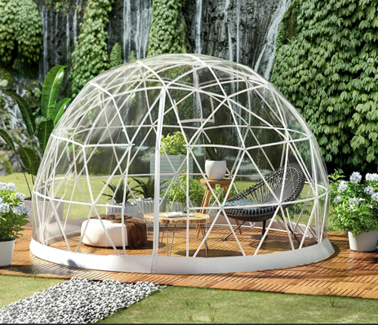
We always welcome suggestions from parents of areas where they think money could be spent and this would be discussed at a committee meeting and with the school. We are a small group of volunteers and would love to grow our numbers for more ideas and help. The more we raise the more money we have to spend on exciting things for our school!
Events coming up
We are having the FOWS annual general meeting on Monday 22nd January at 5.30pm at the school anyone welcome.
Date for your diary our Summer Disco at Blackburn Leisure club is Friday 28 June 2024.
We have a lot of ideas for some great outdoor events in the summer, we’ll keep you posted and we enjoy holding pop up treat shops, such as doughnuts or cakes after school but if there is something else you would love to have at our school get in touch.
ptaweltonprimary@hotmail.com
Friends of Welton School (FOWS) on Facebook
Leave a message for us at the office or have a chat with us on the playground.

