Slide 1

Guess the
Disney
Movie
The Answers….

Slide 2
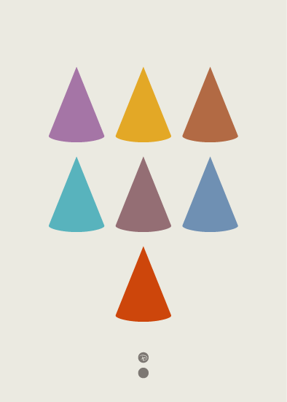
Question 1
Snow white and the seven Dwarfs

Slide 3

Question 2
Pinocchio

Slide 4

Question 3
Fantasia

Slide 5

Question 4
Bambi

Slide 6

Question 5
Cinderella

Slide 7

Question 6
Alice in Wonderland

Slide 8

Question 7
Peter Pan

Slide 9

Question 8
Lady and the tramp

Slide 10

Question 9
Sleeping Beauty

Slide 11

Question 10
101 Dalmatians

Slide 12

Question 11
The Jungle Book

Slide 13

Question 12
Robin Hood

Slide 14

Question 13
The Many Adventures of Winnie the Pooh

Slide 15

Question 14
The Little Mermaid

Slide 16

Question 15
Beauty and the Beast

Slide 17

Question 16
Aladdin

Slide 18

Question 17
The Lion King

Slide 19

Question 18
The Hunchback of Notre Dame

Slide 20

Question 19
Mulan

Slide 21

Question 20
Tangled

